Slide 1
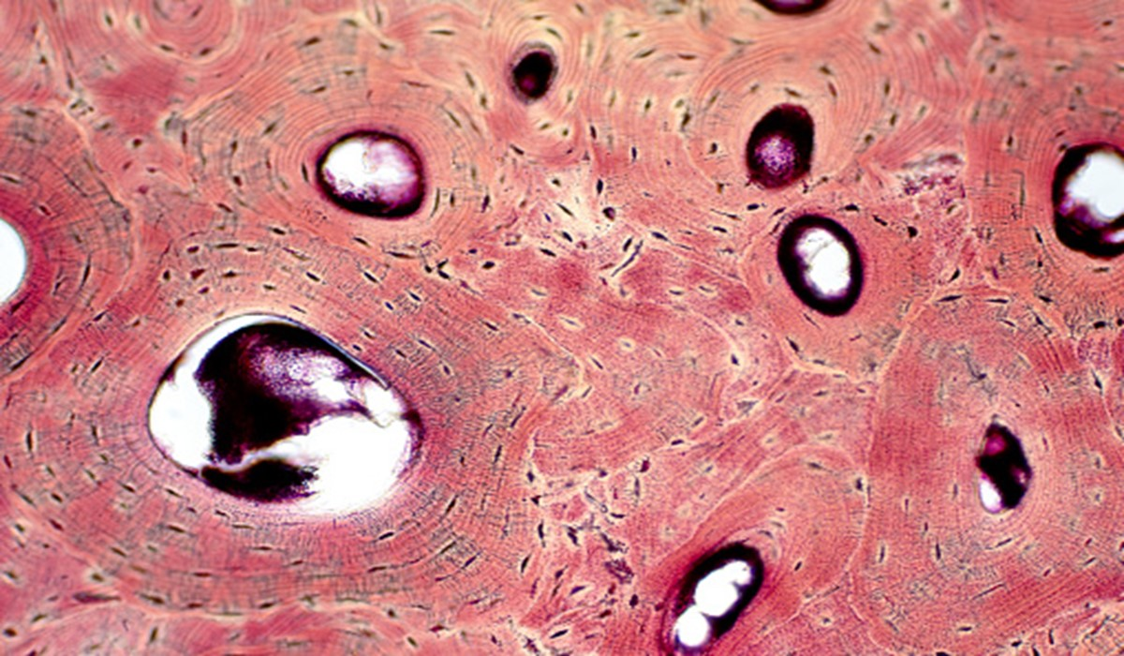
Introduction to Bones and Bone Tissue
Dr. Heather Talbott
Laramie County Community College

Slide 2
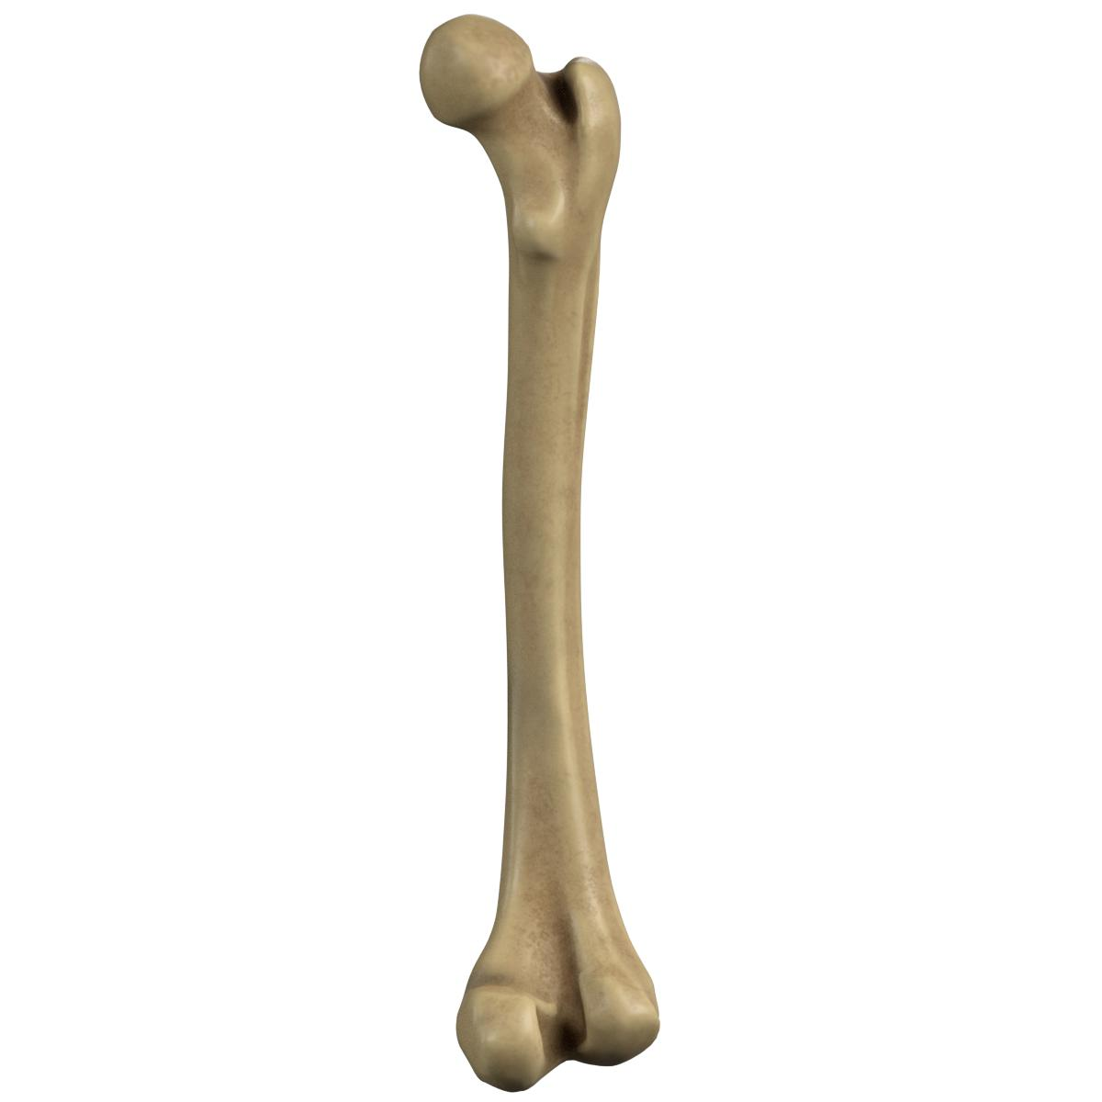
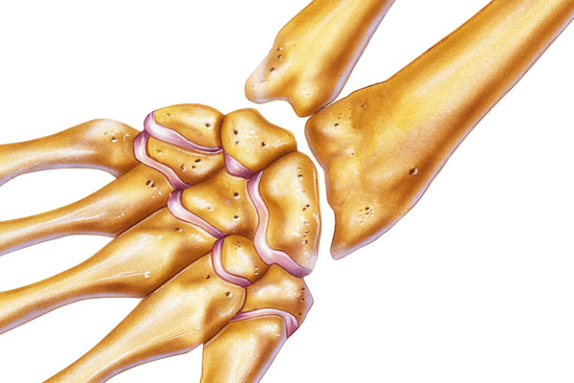
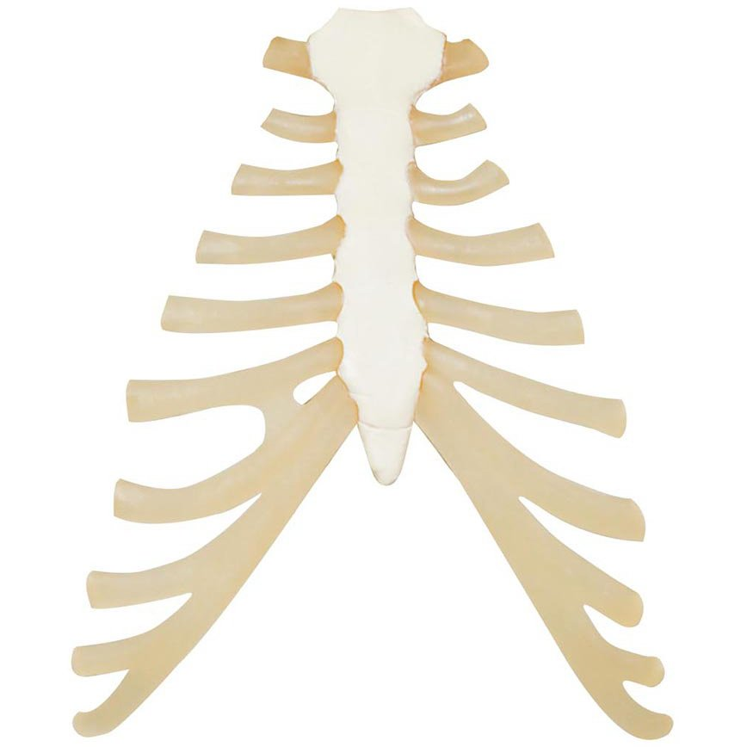
Types of Bones
Long bones: longer than wide → consist of a shaft and a variable number of ends/epiphyses → made mostly of compact bone in their diaphyses but have spongy bone in their epiphyses ex. femur, tibia, fibula, humerus
Short bones: somewhat cubed shaped; nearly equal in length and width → consist of spongy bone except at the surface, which has a thin layer of compact bone ex. carpal and tarsal bones
Flat bones: generally thin and composed of two nearly parallel plates of compact bone tissue enclosing a layer of spongy bone tissue → provide extensive area for muscle attachment and protection ex. cranial bones, sternum, ribs, scapulae

Slide 3
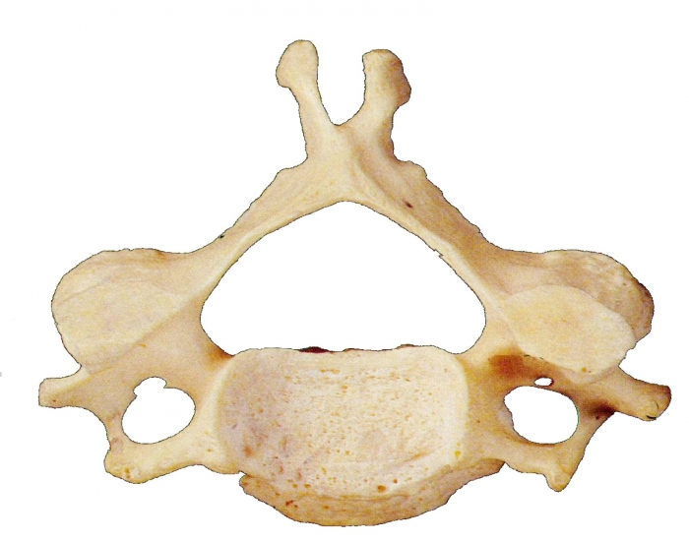
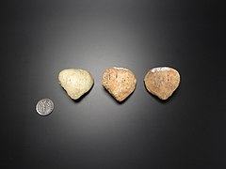
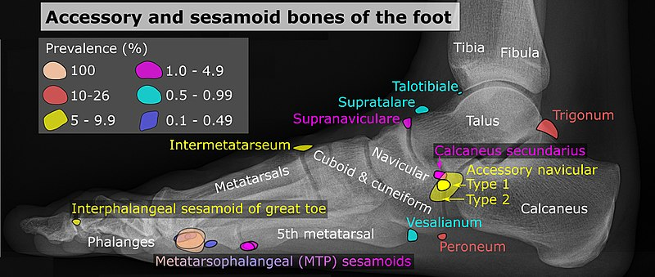
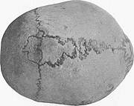
Types of Bones
Irregular bones: have complex shapes and cannot be grouped into any other category ex. vertebrae, hip bones, certain facial bones, calcaneus
Sesamoid bones: (from: sesame seeds) develop in certain tendons where there is considerable friction, tension, and physical stretch ex. patella
Sutural bones: small bones located in joints/sutures between certain cranial bones

Slide 4
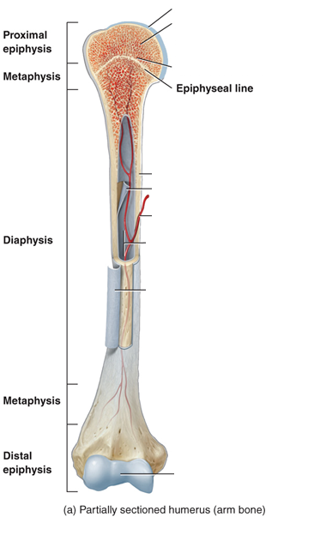
General Bone Structure
Epiphyses: ends of the bone
Epiphyseal growth plate: layer of hyaline cartilage where the bone grows in length
When a bone stops growing, the cartilage is replaced with bone
Metaphyses: regions between the diaphysis and epiphyses
Diaphysis: bone shaft/body; makes up the long, cylindrical portion of the bone

Slide 5
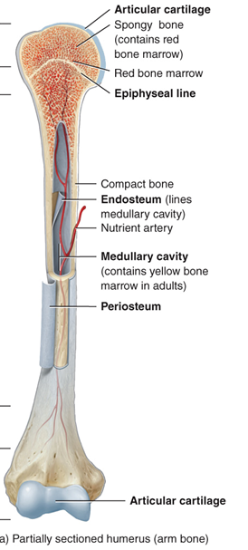
General Bone Structure
Articular cartilage: thin layer of hyaline cartilage covering the part of the bone that forms a joint (articulation)
Periosteum: tough connective tissue sheath that surrounds the bone surface wherever it is not covered by articular cartilage
Medullary cavity (aka marrow cavity): hollow cylindrical space containing fatty yellow bone marrow
Endosteum: thin membrane that lines the medullary cavity

Slide 6
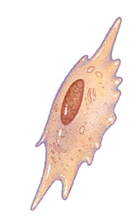
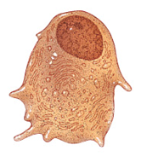
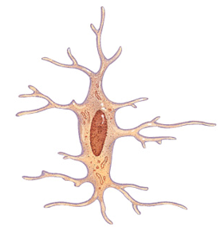
Bone Cytology
Osteoprogenitor cells: unspecialized bone stem cells
Only bone cells undergoing cell division
Osteoblasts: bone-building cells
Bone deposition: make collagen fibers and ECM of bone tissue and starts calcification (hardening)
Blasts build bone
Osteocytes: mature bone cells (main cells in bone)
Maintain daily metabolism

Slide 7
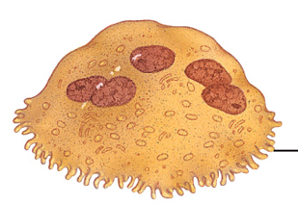
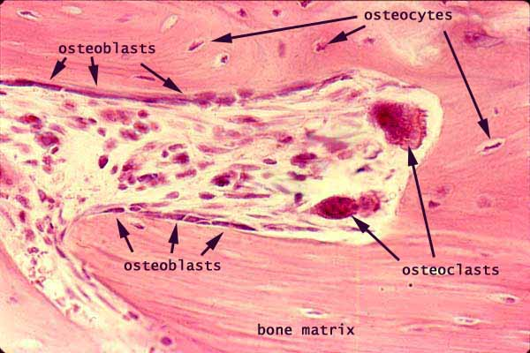
Bone Cytology
Osteoclasts: bone-degrading cells
Bone resorption: digestion of bone by release of lysosomal enzymes and acids
Huge cells concentrated in the endosteum (lining the medullary cavity)
Start life as a white blood cell
https://histology.siu.edu/ssb/images/remodel.jpg
Notes:
https://histology.siu.edu/ssb/images/remodel.jpg

Slide 8
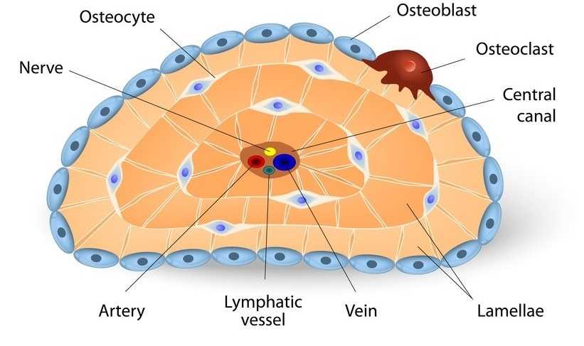
Compact Bone Tissue
Compact bone tissue: provides protection and support
location: outside of bones, beneath the periosteum
structure: osteons (aka haversian systems): repeating tree-like structural units

Slide 9
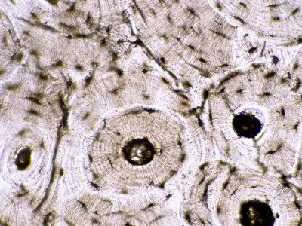
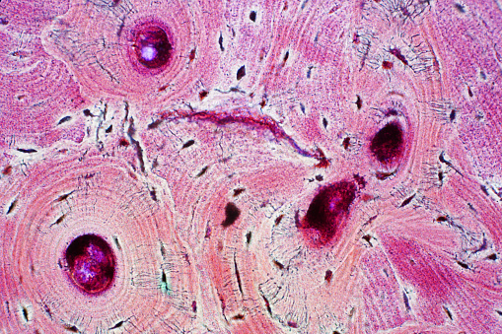

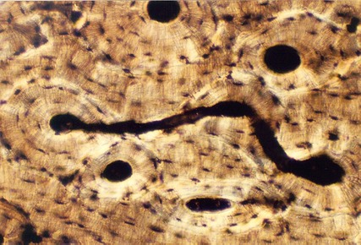
Compact Bone Tissue – Histology

Slide 10
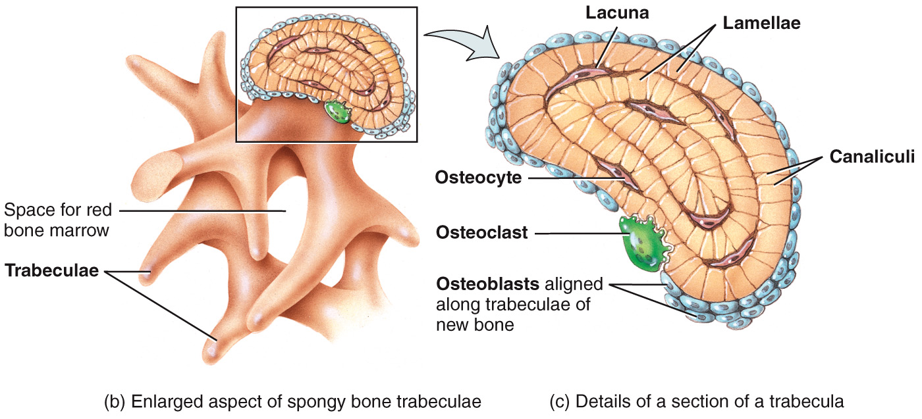
Spongy Bone Tissue
Spongy bone tissue: lightweight; provides tissue support
location: in the interior of the bone, protected by a covering of compact bone
structure: trabeculae: consists of irregular pattern of sponge/web-like layers of bone tissue (lamellae) supports red and yellow bone marrow

Slide 11
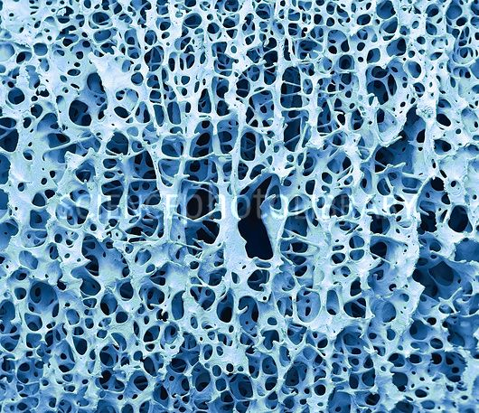
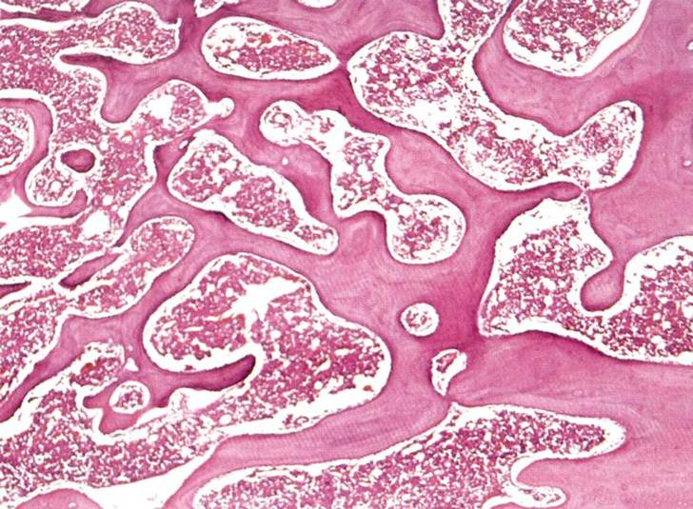
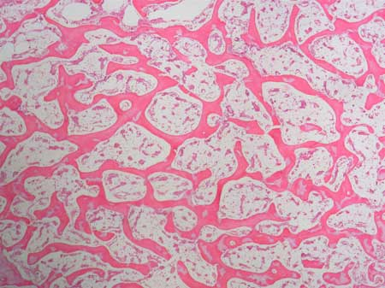
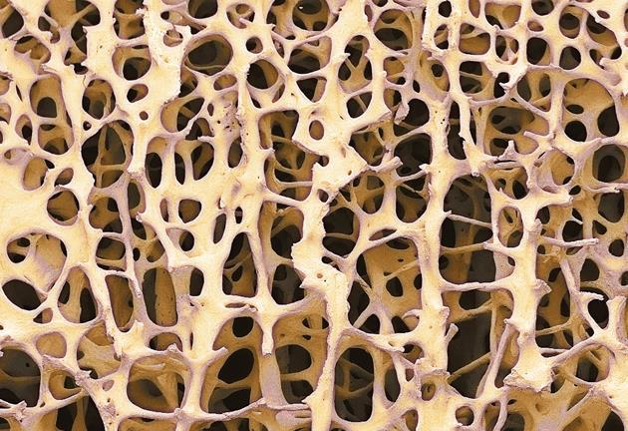
Spongy Bone Tissue – Histology

Slide 12
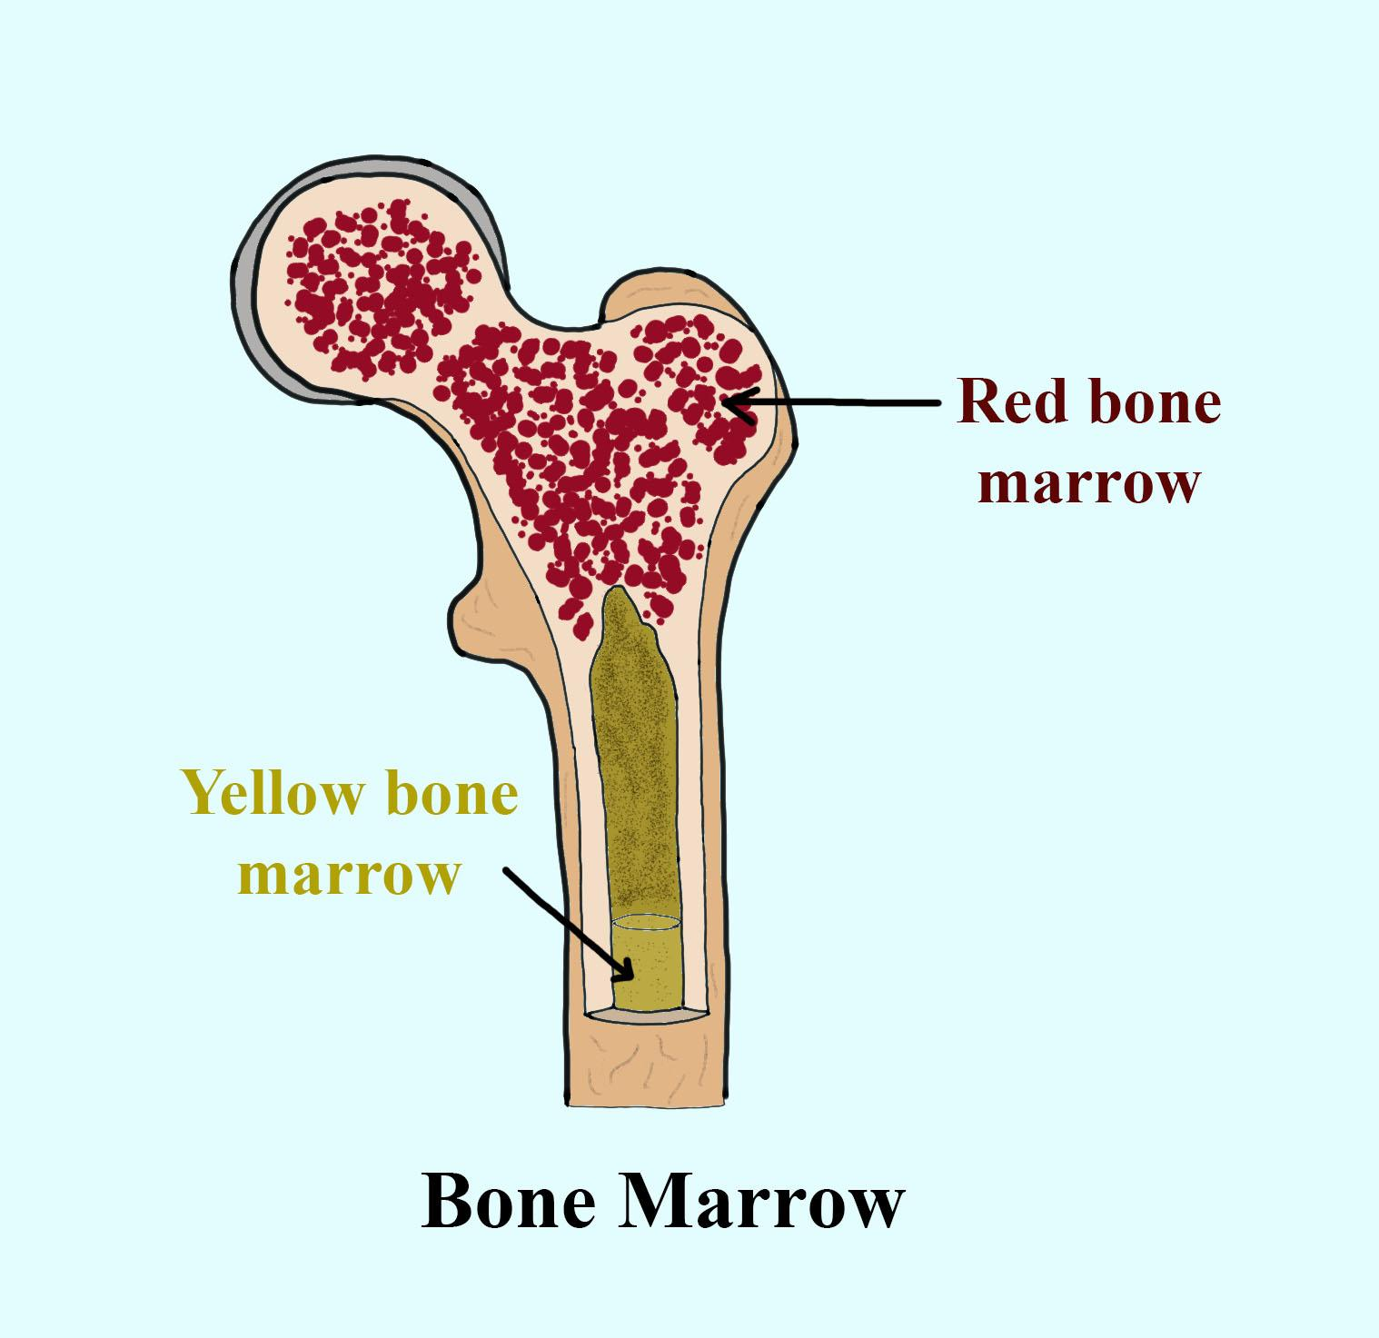
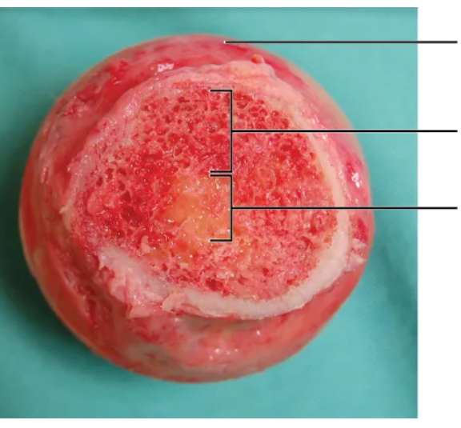
Bone Marrow
Red bone marrow: → located between the trabeculae of certain bones (ex. ribs, sternum, vertebrae, long bones) → primary source of new blood cells
Yellow bone marrow: → located in diaphysis of long bones like the femur, tibia, and humerus → comprised of adipocytes
Outer bone surface
Red marrow
Yellow marrow

Slide 13
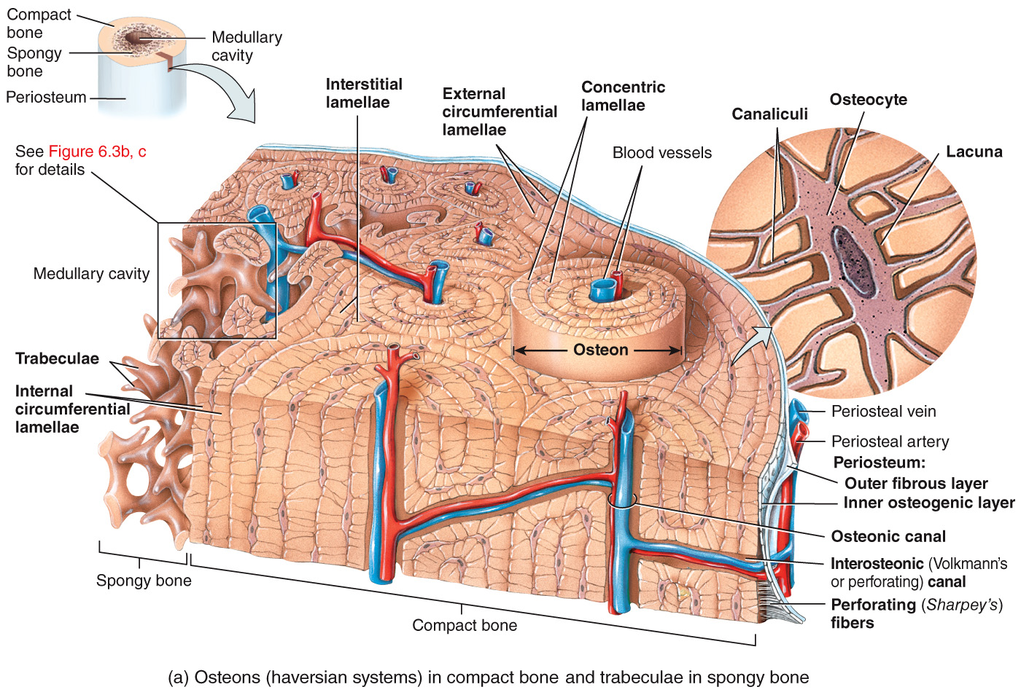
Compact vs. Spongy Bone

Slide 14
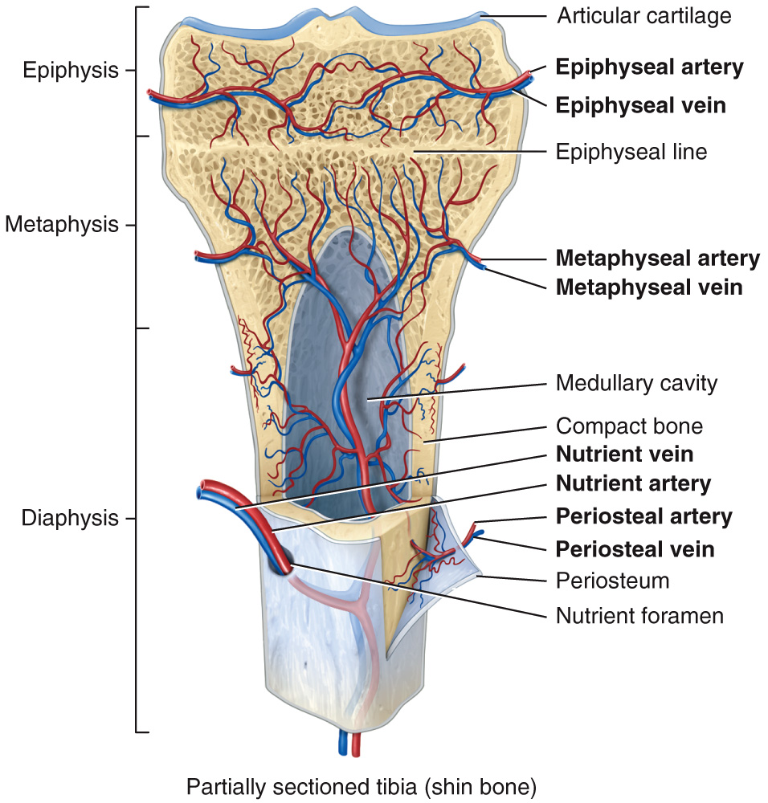
Blood Supply

Slide 15
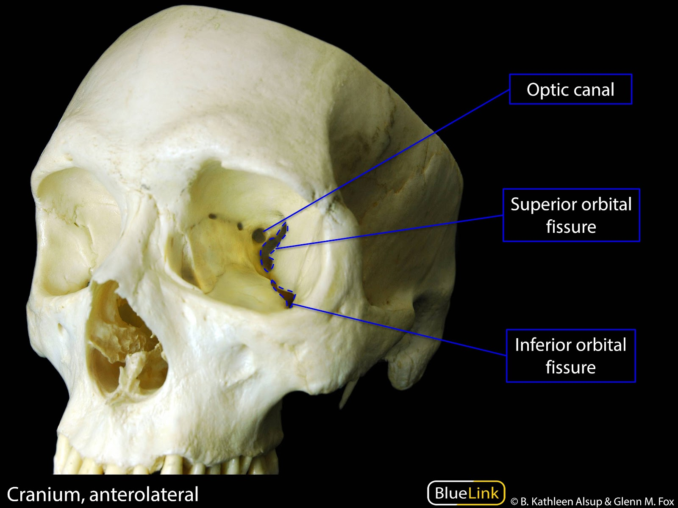
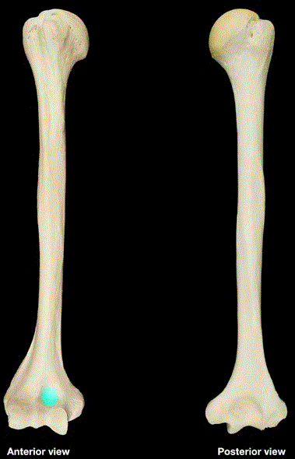
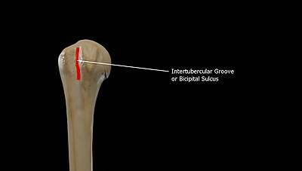
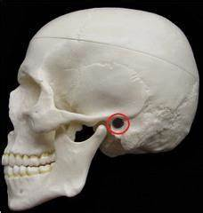
Depressions and Openings Vocab
Fissure: narrow slit between adjacent parts of bone thru which nerves/vessels pass
Foramen: large opening that blood vessels/nerves/ligaments pass thru
Fossa: shallow depression
Sulcus: furrow along bone surface that accommodates blood vessels/nerves/tendons
Meatus: tube-like opening
orbital fissure
optic foramen
(sphenoid bone)
coronoid fossa (humerus bone)
intertubercular sulcus (humerus bone)
auditory meatus (temporal bone)

Slide 16
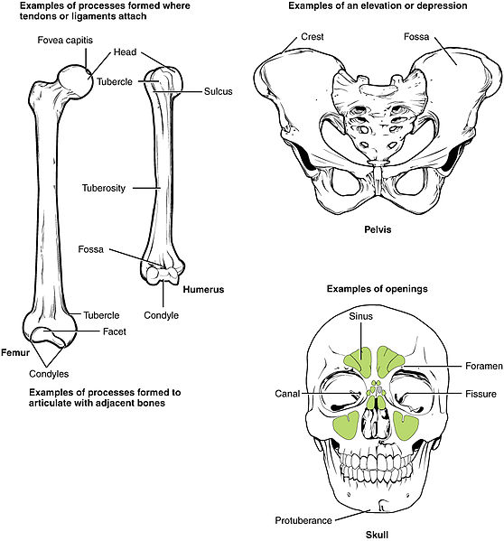
Joint Processes Vocab
Condyle: large, round projection/protuberance with a smooth articular surface at end of bone
Facet: smooth, flat, slightly concave or convex articular surface
Head: rounded articular projection supported on narrower neck on bone

Slide 17
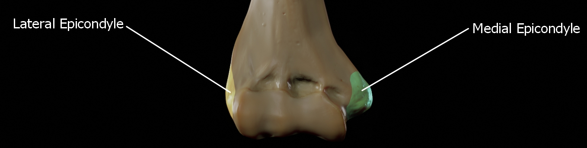
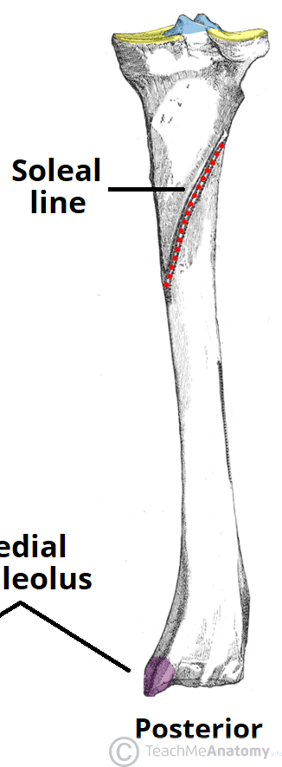
Attachment Processes Vocab
Crest: prominent ridge or elongated projection
Epicondyle: rough projection above condyle
Line: long narrow ridge or border (less prominent than a crest)

Slide 18
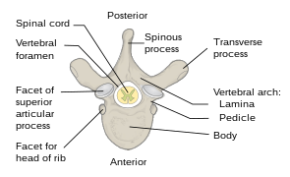
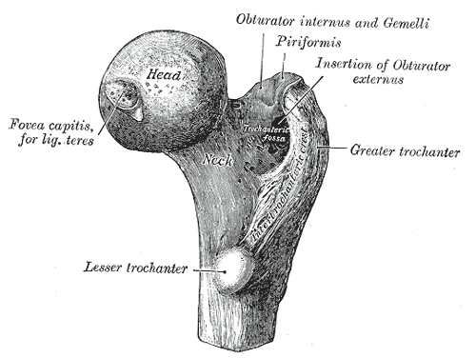
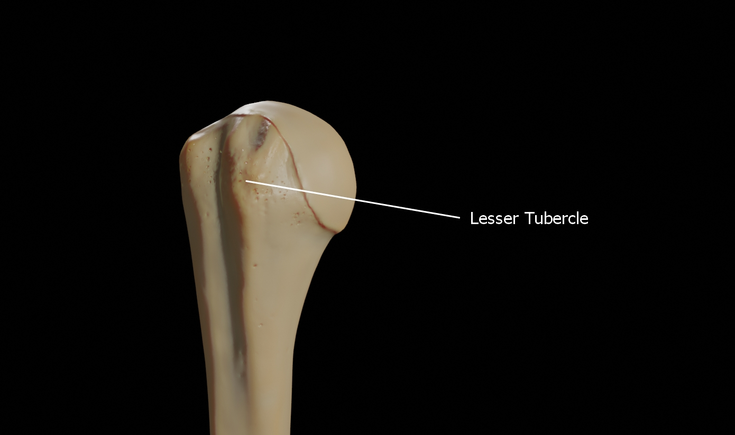
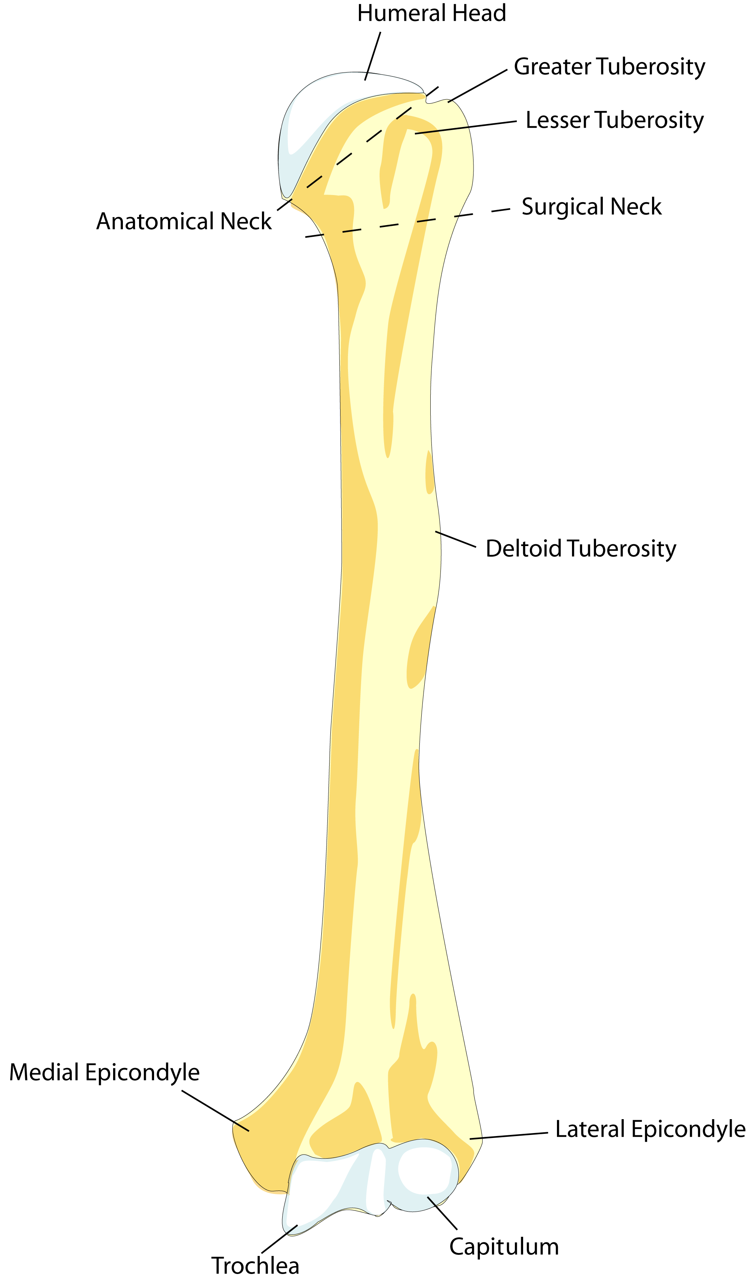
Attachment Processes Vocab
Spinous process: sharp, slender projection
Trochanter: very large projection
Tubercle: variably sized round projection
Tuberosity: variable sized projection that has rough bumpy surface

Slide 19
Function of Bones
support: structural framework for the body
protection: protects the most internal organs from injury
movement: muscles pull on bones to produce movement
mineral homeostasis: stores several minerals (esp. calcium and phosphorous) important for muscle and nerve function
blood cell production: red bone marrow produces red blood cells, white blood cells, and platelets in a process known as hemopoiesis
triglyceride storage: yellow bone marrow consists mainly of adipose cells

Slide 20

Activity/Assignment: Bone Introduction
Station 1: Bone Classification
Exercise 8: Lab Activity 1 & 2
p 98-99
Also: ID at least 4 bone markings, write it down
Station 2: Microscopic Structure
Anatomy TV
Exercise 8: Lab Activity 4
p 99-101
Station 3: Fresh Long Bone
Exercise 8: Lab Activity 3
WEAR GLOVES
p 99
Station 4: Osseus ECM & Marrow
Exercise 8: Lab Activity 5
p 102

